Slide 1
Recreational and Occupational Therapy
College and Career Awareness

Slide 2
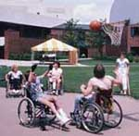
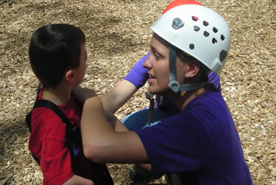
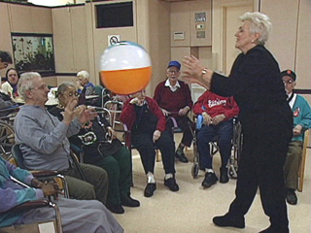
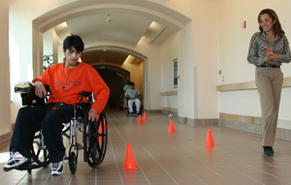
What is a Recreational Therapist?
Provide treatment and activities for people with disabilities or illnesses.

Slide 3
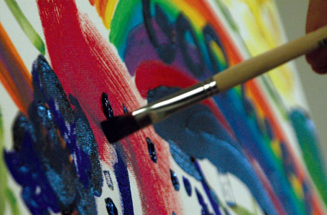
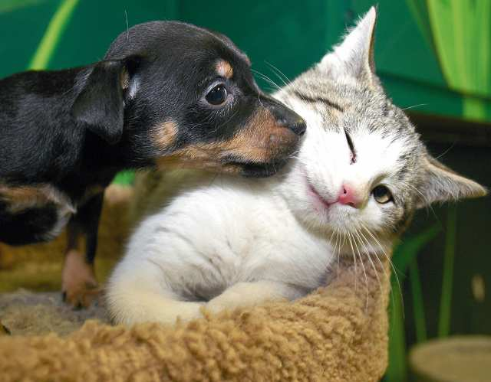
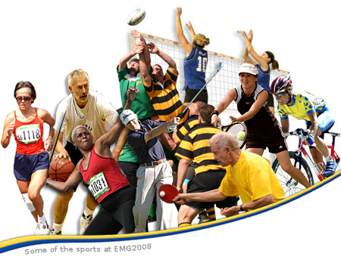
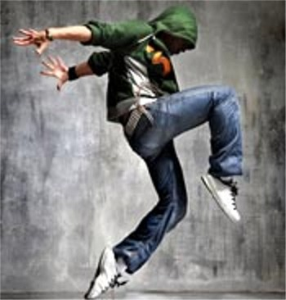
What is a Recreational Therapist?
What do Recreational Therapists use?
Arts and Crafts
Animals
Sports
Games
Dance and Movement
Drama
Music
Community Outings

Slide 4
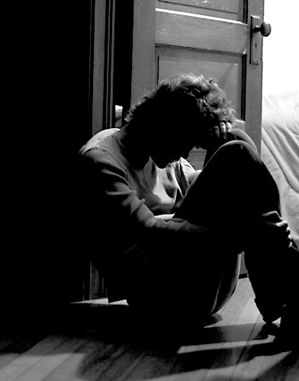
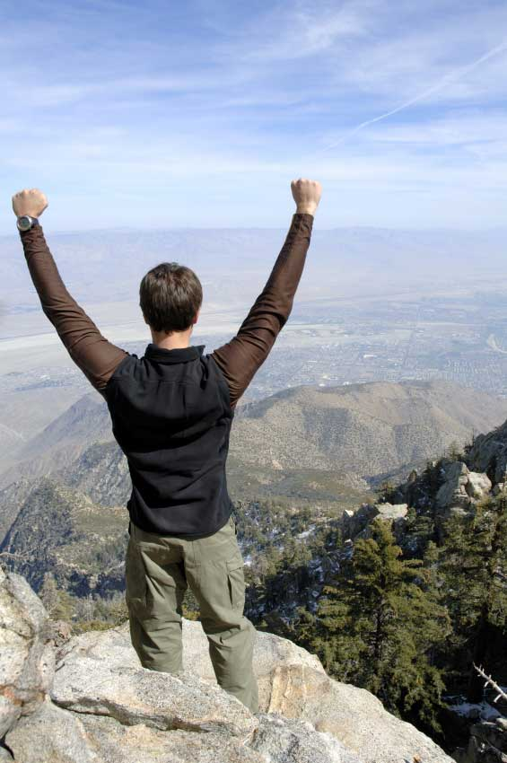
What do they help with?
Reduce depression
Stress
Anxiety
Recover basic movements
Build confidence
Socialize effectively
Enjoy greater independence
Become involved with the community

Slide 5
Where do they work?
Nursing and personal care facilities
Hospitals
Residential facilities
Community mental health centers
Adult day care programs
Correctional facilities
Community programs
Substance abuse centers

Slide 6
How do I become a Rec. Therapist?
Bachelor’s degree (4 years of college)
Utah requires a license to practice

Slide 7
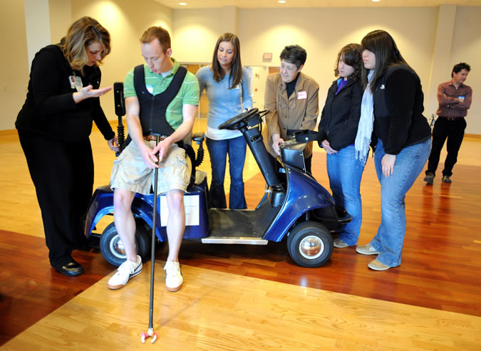
How hard will it be to find a job?
Jobs will increase 15% from 2008-2018
More jobs available than most careers
Aging population = more jobs

Slide 8
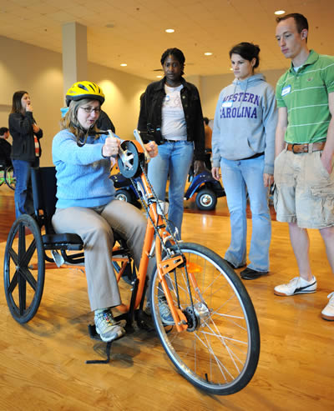
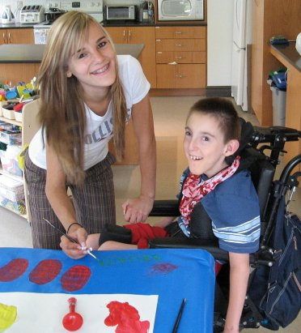
How much can I make?
Average pay in 2014 is approximately $42,820 per year. $20.33 per hour.

Slide 9
What is an Occupational Therapist?
Help people of all ages participate in things they need to do each day.
Example – helping children with disabilities participate in school.

Slide 10
What do they help with?
Eating
Walking
Dressing
Changing body positions
Carrying objects
Cooking
Cleaning
And many more…

Slide 11
Where do they work?
Hospitals
Rehab Centers
Nursing Facilities
Clinics
Schools
Community Centers

Slide 12
How do I become an Occupational Therapist
Bachelor’s degree (4 years of college)
Utah requires a license to practice

Slide 13
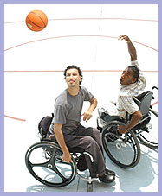
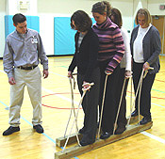
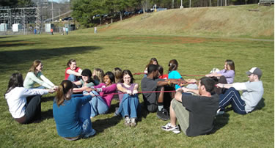
Learn Activities
Now it’s your turn to do some Recreational Therapy activities.

