Slide 1
American Architecture
These American styles have many influences on buildings designed today. You will find many characteristics of them still today.

Slide 2
Traditional American
Georgian
Federal
Greek Revival
Cape Cod
Garrison
Salt Box
Dutch Colonial
Jeffersonian

Slide 3
Georgian
Named the for the four King Georges
1720-1840
Imported from England
(originals of these houses only exist in the 13 colonies)
Symmetrical structure (proportion & balance 4x4)
Hip or gable roof with dormer windows
Widows walk
Symmetrical windows with small panes of glass
Dentil cornice & relieving arches

Slide 4
Georgian

Slide 5
Federal
Popular just after Revolutionary War
1780-1830
Pediment
Fanlight & column surrounding door
2-3 stories high
Rectangular
Lower windows taller than upper ones

Slide 6
Federal
Some other things to know:
Classical features reflect the new country embracing Greek style government.
Reflects anti-English and pro-democratic thought.
A rebellion against Georgian Style

Slide 7
Greek Revival
Reached height of popularity just before Civil War
1820-1850
Pedimented portico
Sidelights with transom
Symmetrical
Associated with classical thought and democracy

Slide 8
Greek

Slide 9
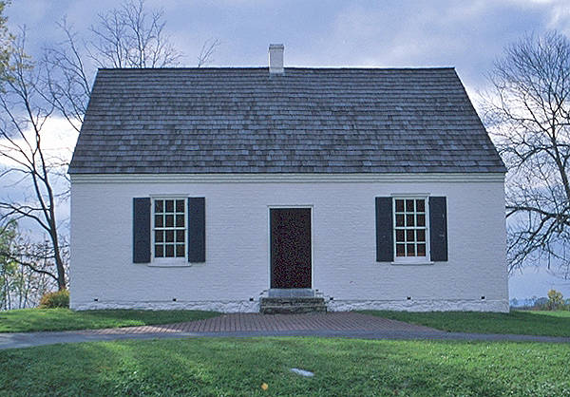
Cape Cod
Colonial Style
Late 1690 to 1850
Gable roofs
1 level + loft/attic
Central chimney & door
Symmetrical
2 windows on each side of the door
Clapboard siding

Slide 10
Cape Cod
“Rediscovered” 1920-1950
1½ stories
Living space in attic
Dormer windows
Shutters
Chimney relocated
Wings to the side or on the rear

Slide 11
Garrison
Common in English medieval construction.
Ornamental drops shaped like cannonballs under the jetty.
They have a overhang
Traditionally clapboard.
Central chimney
Revival 1920-1960

Slide 12
Garrison

Slide 13
Salt Box
Roof is similar to Colonial salt container
Originated in the Colonial era around New England
Popular from 1920-1970
Had a long rear roof
Central chimney
Usually 2-3 stories high
Has shutters

Slide 14
Dutch Colonial
1670-1760’s
Broad Gambrel roof
Flaring eaves
End chimneys
Double hung windows
Dutch doors (double)
Revival 1900-1930

Slide 15
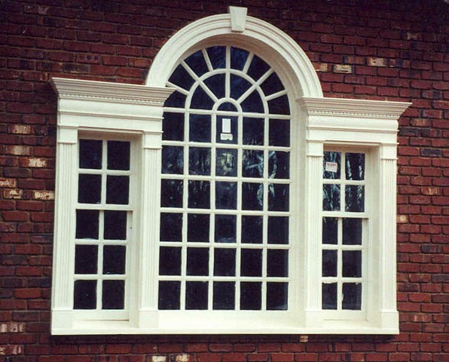
Jeffersonian
Thomas Jefferson
1790’s-1830’s
Ocatagons
Greek entrances
Palladian windows
Monticello

Slide 16
Victorian
Queen Anne
Second Empire
Gothic

Slide 17
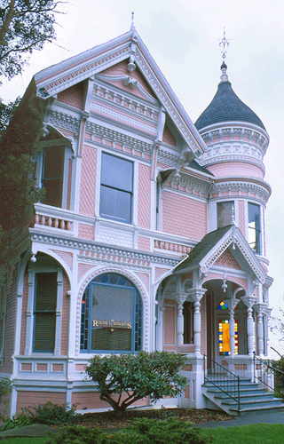
Queen Anne
Popular in small towns and cities
Popular from 1880-1900
Wrap around porches
Often have towers
Exterior is various materials and has lots of decorative trim (gingerbread)

Slide 18
Second Empire
Popular in the 19th century in France
Came to be associated with Haunted Houses
Mansard roof
Windows hooded and may have corner quoins

Slide 19
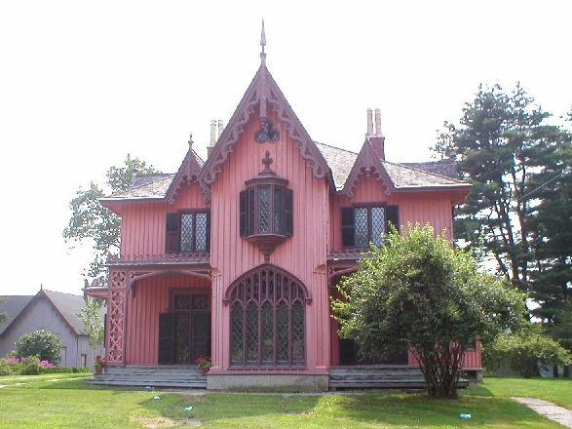
Gothic
Irregular shape & floor plans
Steeply pitched roof
Elaborate vergeboard trim
High dormers
Gothic arch windows

Slide 20
Familiar American
Ranch
Split-Level
Farmhouse
Bungalow (Craftsman)
Prairie Style
Contemporary Rustic

Slide 21
Ranch
Originated in California in the 1930s
Most common of American house styles
Reached its popularity during Eisenhower’s presidency
Long, low bank of windows
There is an attached garage carport
Back patio

Slide 22
Split Level
Innovative spin off of the Ranch style
Exterior similar to Ranch Style except for two-story wing
Usually brick or brick and wood combination
Interior space is split into three levels
Lowest = utility and den, Middle = kitchen & living room, Upstairs = bedrooms

Slide 23
Farmhouse
A two-story home with one story front porch
Gable roofs and dormer windows are common
Suburban homes in the late 20th century

Slide 24
Bungalow
It started in California and spread across the country and became the most middle-class house design
It started to 1910 to the 1930s
They have a fairly deep porch and wide overhangs

Slide 25
Prairie
A product of the vision of Frank Lloyd Wright
Popular from about 1900 through the 1920s.
A hipped roof, French doors, Wide eaves and craftsman windows and coulmns

Slide 26
The Waterfall House
One of Frank Lloyd Wright’s most famous designs.
Includes natural features of the property into the architecture.
Fallingwater

Slide 27
Contemporary Rustic
Expression of the 1960’s nature movement
Started in California and spread across America in 1960s -1970s
Has wood siding typically with many different angles (diagonal)
Windows are grouped into geometric compositions and come in various geometric shapes.
Deck sprung from this style

Slide 28
European
Baroque
Chateauesque
Romanesque
Mediterranean
Tudor

Slide 29
Baroque
Architecture of the late Renaissance period
Classic ornamentation
Keystones or pediments over windows
Balustrades on roof
Balconies and patios
Stucco and corner quions
Hip roof flared at eaves

Slide 30
Chateauesque
Popular at turn of the century among wealthy
Always masonry
Formal arch entryway
Window surrounds or keystones
Steeply pitched roof –usually hipped
Demi-dormer (windows break through roof line)
Towers with conical roof
Paired windows
Semicircular arches
Transom bar

Slide 31
Romanesque (revival)
Constructed of rough-faced, square stones
Round towers with cone-shaped roofs
Columns and pilasters with spirals and leaf designs
Low, broad "Roman" arches over arcades and doorways
Patterned masonry arches over windows

Slide 32
Spanish/Mediterranean
Roots in California and Florida
Popular 1920-1940
Barrel tile roof
Stucco exterior
Wrought iron work
Arcade

Slide 33
Tudor (revival)
Roots in Old English style
Revival began in 1970
Half timbering
Also uses stone and/or brick
Windows are small paned and usually diamond shape

Slide 34
Resources
http://architecture.about.com/cs/teacherstools/a/architecture101.htm
http://architecture.about.com/library/bl-styles_index.htm
http://www.architecturetoursla.com/gallery.htm
http://www.bc.edu/bc_org/avp/cas/fnart/fa267/contents.html
http://www.geocities.com/asiedydd/styles.htm
http://www.greatbuildings.com/types.html
http://www.infoplease.com/encyclopedia/1arch.html
http://www.loggia.com/designarts/architecture/styles/styleguide.html
http://www.preservationdirectory.com/architecturalstyles.html
http://www.uwec.edu/geography/Ivogeler/w367/styles/

