Slide 1
Professional Business Letters
OHMS
Career & Technical Education: Keyboarding

Slide 2
Objectives
Understand how to format a formal business letter
Practice formatting business letters

Slide 3
Business Letters
Business letters are formal letters
They help business communicate with other businesses and/or with their customers

Slide 4
Business Letter Styles
There Are Two Main Business Letter Styles
Full Block
Modified Block
We Will Be Studying Full Block Business Letters

Slide 5
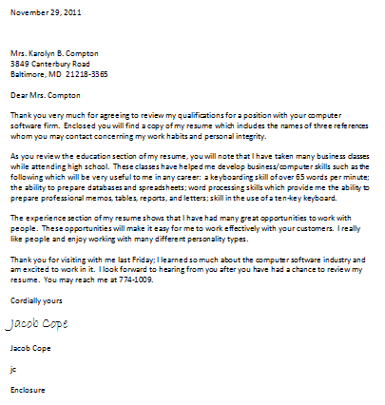
Full Block Business Letter

Slide 6
Parts of a Full Block Letter
Date Line
Inside Address
Salutation
Body
Signature Block
Typists Initials
Enclosure Notification

Slide 7
Date Line
The date line is used to indicate when the letter was written
Quadruple space after the date line

Slide 8
Inside Address
The inside address is the address of the person to whom the letter is written
You should double space after the inside address

Slide 9
Salutation
The salutation is the greeting line of the letter
Double space after the salutation

Slide 10
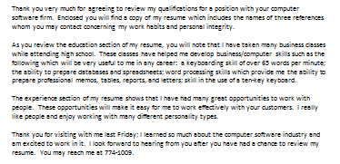
Body
The body is used to relay information
Paragraphs are single spaced, double spacing is used between paragraphs

Slide 11
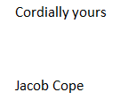
Signature Block
The signature block is used to close the letter and contains two parts:
The complimentary close
The writer’s name

Slide 12
Signature Block—Complimentary Close
The complimentary close should be formal. Examples include:
Cordially yours
Sincerely
Quadruple space after the complimentary close

Slide 13
Signature Block—Author’s Name
The name of the author is typed after the complimentary close
Double space after the author’s name

Slide 14
Typist’s Initials
The typist types their initials (in lowercase letters) following the author’s name
Double space after the typist’s initials

Slide 15
Enclosure Notification
The enclosure notification indicates that there are other documents enclosed with the letter
If there are no other documents enclosed with the letter, an enclosure notification is not needed.

Slide 16
Full Block Letter Format
All letter parts are left aligned
The page is centered from top to bottom
No punctuation is used after the salutation and the complimentary close (open punctuation)
The letter is signed by the writer between the complimentary close and the writer’s name

Slide 17
Example

Slide 18
Standard & Objective
STANDARD 3—Students will demonstrate a working knowledge of basic word processing functions and proofreading.
OBJECTIVE 1—Students will apply basic word processing functions using a variety of documents.
STANDARD 4—Students will develop skill composing at the keyboard.
OBJECTIVE 1—Students will demonstrate composition skills at the keyboard.

