Slide 1
Identify the X-Ray Activity
Health Science Lesson 14
Radiology Technician

Slide 2
What You Must Do
View each of the slides below.
Match the X-Ray image to the proper medical issue on the worksheet.

Slide 3
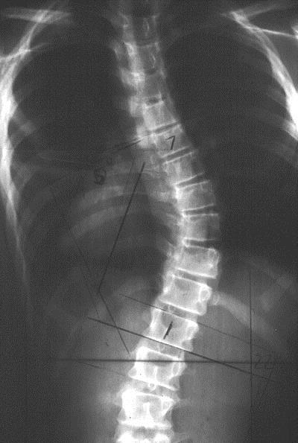
X-Ray 1

Slide 4
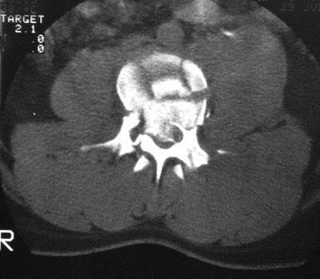
X-Ray 2

Slide 5
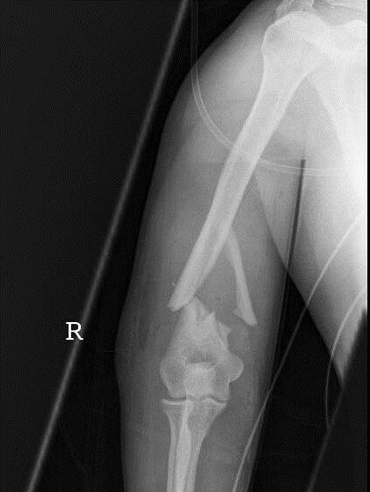
X-Ray 3

Slide 6
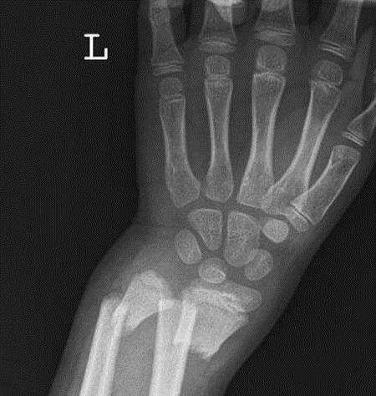
X-Ray 4

Slide 7
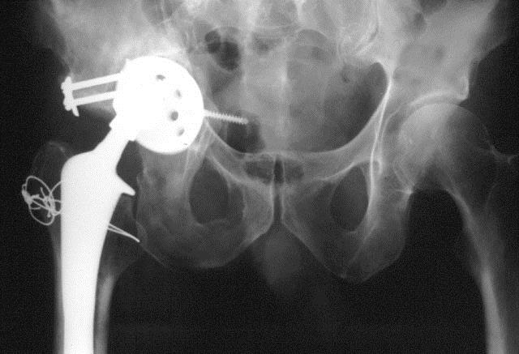
X-Ray 5

Slide 8
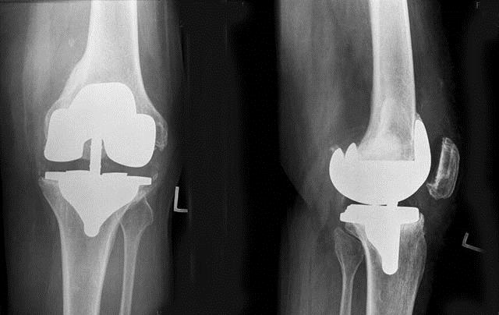
X-Ray 6

Slide 9
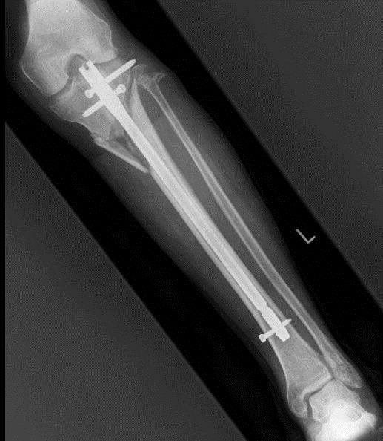
X-Ray 7

Slide 10
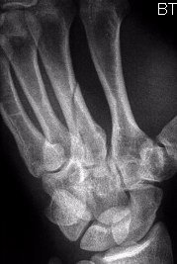
X-Ray 8

